Slide 1
SciLifeLab Bioinformatics Platform National Bioinformatics Infrastructure Sweden (NBIS)
Björn Nystedt
www.nbis.se
RNA course
Uppsala 13.03.2017

Slide 2

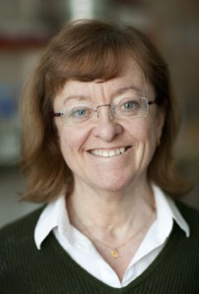

SciLifeLab
SciLifeLab
National service
The Swiss army knife for Swedish
Life Science researchers
Local scientific center
Director: Olli Kallioniemi
Co-director: Lena Claesson-Welsh
Vision:
To be an internationally leading center that develops, uses and provides access to advanced technologies for molecular biosciences with focus on health and environment.
2010: Strategic research initiative
2013: National resource
2015: New management/chairman
www.scilifelab.se

Slide 3
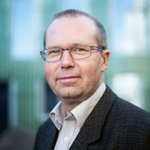

SciLifeLab platforms
SciLifeLab national service
VR
National Genomics Infrastructure
Next Generation Diagnostics
Single-cell omics
National Bioinformatics Infrastructure
Sweden
SNIC
Bengt Persson
Computer resources free for Swedish researchers
Merge of BILS, WABI and more; complete 2016. National, distributed

Slide 4
Bioinformatics as infrastructure

Slide 5
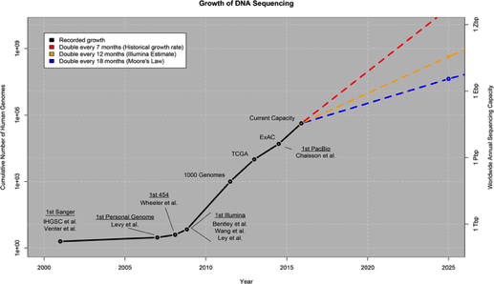
Data growth

Slide 6
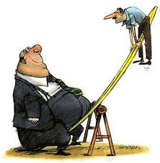
Production is cheap, analysis is not
Cost
Data
Year
“Per base”
.
Our role
We want to help the Swedish Life Science community to build knowledge in large-scale data analysis, and to make bioinformatics easily accessible for all.
Data scientists
Data

Slide 7
Production is cheap, analysis is not
Cost
Cost
Bioinformatics analyses
Computing
Data
Data
Year
Year
“Per base”
“Per project”
.
Our role
We want to help the Swedish Life Science community to build knowledge in large-scale data analysis, and to make bioinformatics easily accessible for all.
Data scientists
Data

Slide 8
NBIS activities

Slide 9





Support, tools and training
Support
Tools
Training
Support
Tools
Training

Slide 10
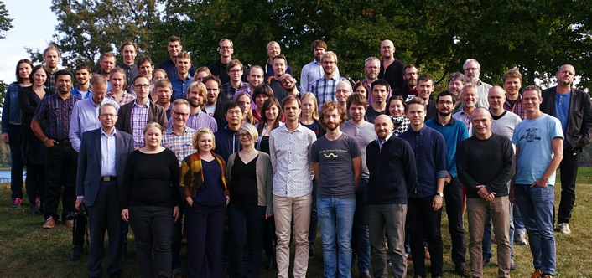
4 facilities, ~60 FTEs
Support and Infrastructure Wide competence in bioinformatics, Assembly/Annotation, SysDev
Long-term support (WABI) Large collaborative projects selected by scientific ranking
Systems biology Network analyses and Integrative bioinformatics
Compute and storage Computational and storage resources for bioinformatics, especially next-generation sequencing

Slide 11



NBIS
Customized
Long time per project
Bioimage
informatics
Systems
biology
5/y
Training
5 FTE
20 FTE
Scientific ranking
20/y
5 FTE
20 FTE
Fee-for-service
200/y
Systems development
1 FTE
5 FTE
Compute and storage
800/y
Standardized
Short time per project
Data management
Custom-tailored support

Slide 12

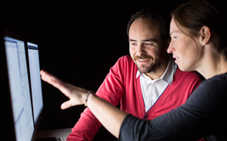
User benefits
Design of compute, storage, archiving
Study design, Consultation, Grant applications
Compute resource allocation
Support
Tools
Training
Data submission, Reproducibility

Slide 13
Support

Slide 14
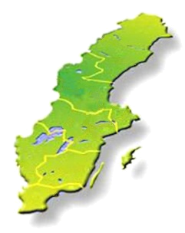
Custom-tailored support
www.scilifelab.se/platforms/bioinformatics/
www.nbis.se
Study design consultation (free) www.nbis.se/support/supportform/index.php + drop-in sessions every week @ 6 sites
Short- and Medium-term support (User fee 800 kr/h) www.nbis.se/support/supportform/index.php
Long-term support and systems biology (500h, free, scientific evaluation) www.nbis.se/support/supportform/index.php?form=longterm

Slide 15
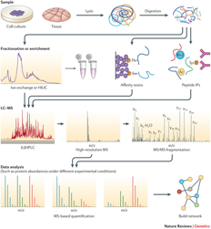

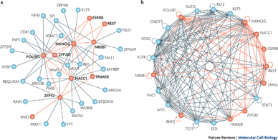
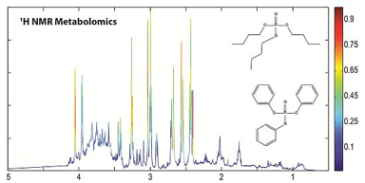

Bioinformatics support
Proteomics
Systems biology
Genomics
2 tracks!
Fee-for-service (800kr/h) Rapid turnaround
Scientific ranking (free) “Long-term Support” 3 rounds/year
Biostatistics
Metabolomics

Slide 16
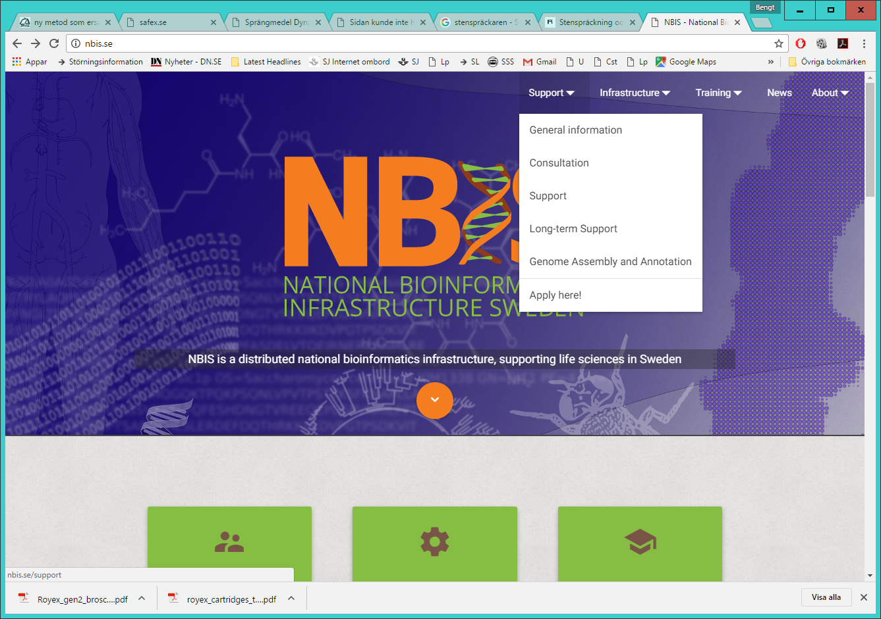
How to get support nbis.se

Slide 17
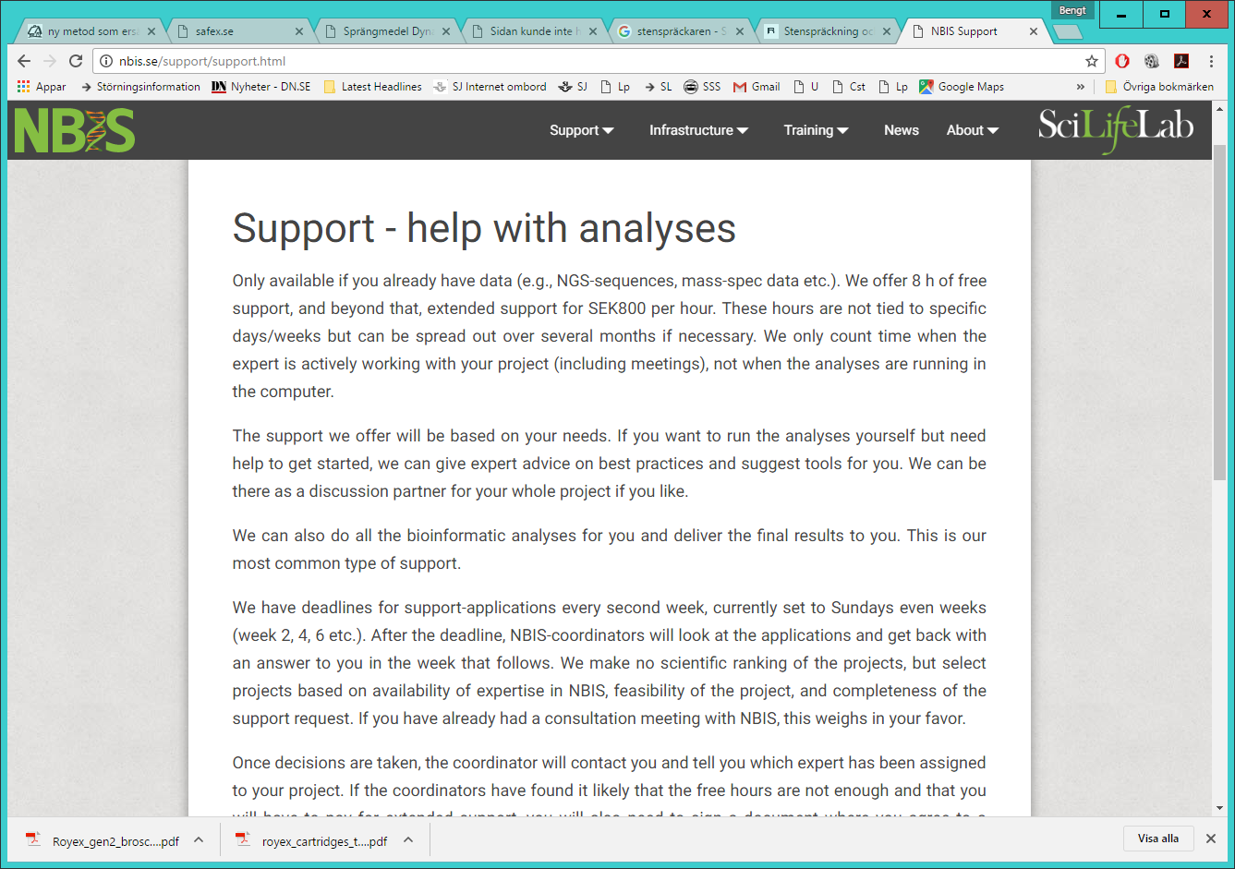
Support information

Slide 18
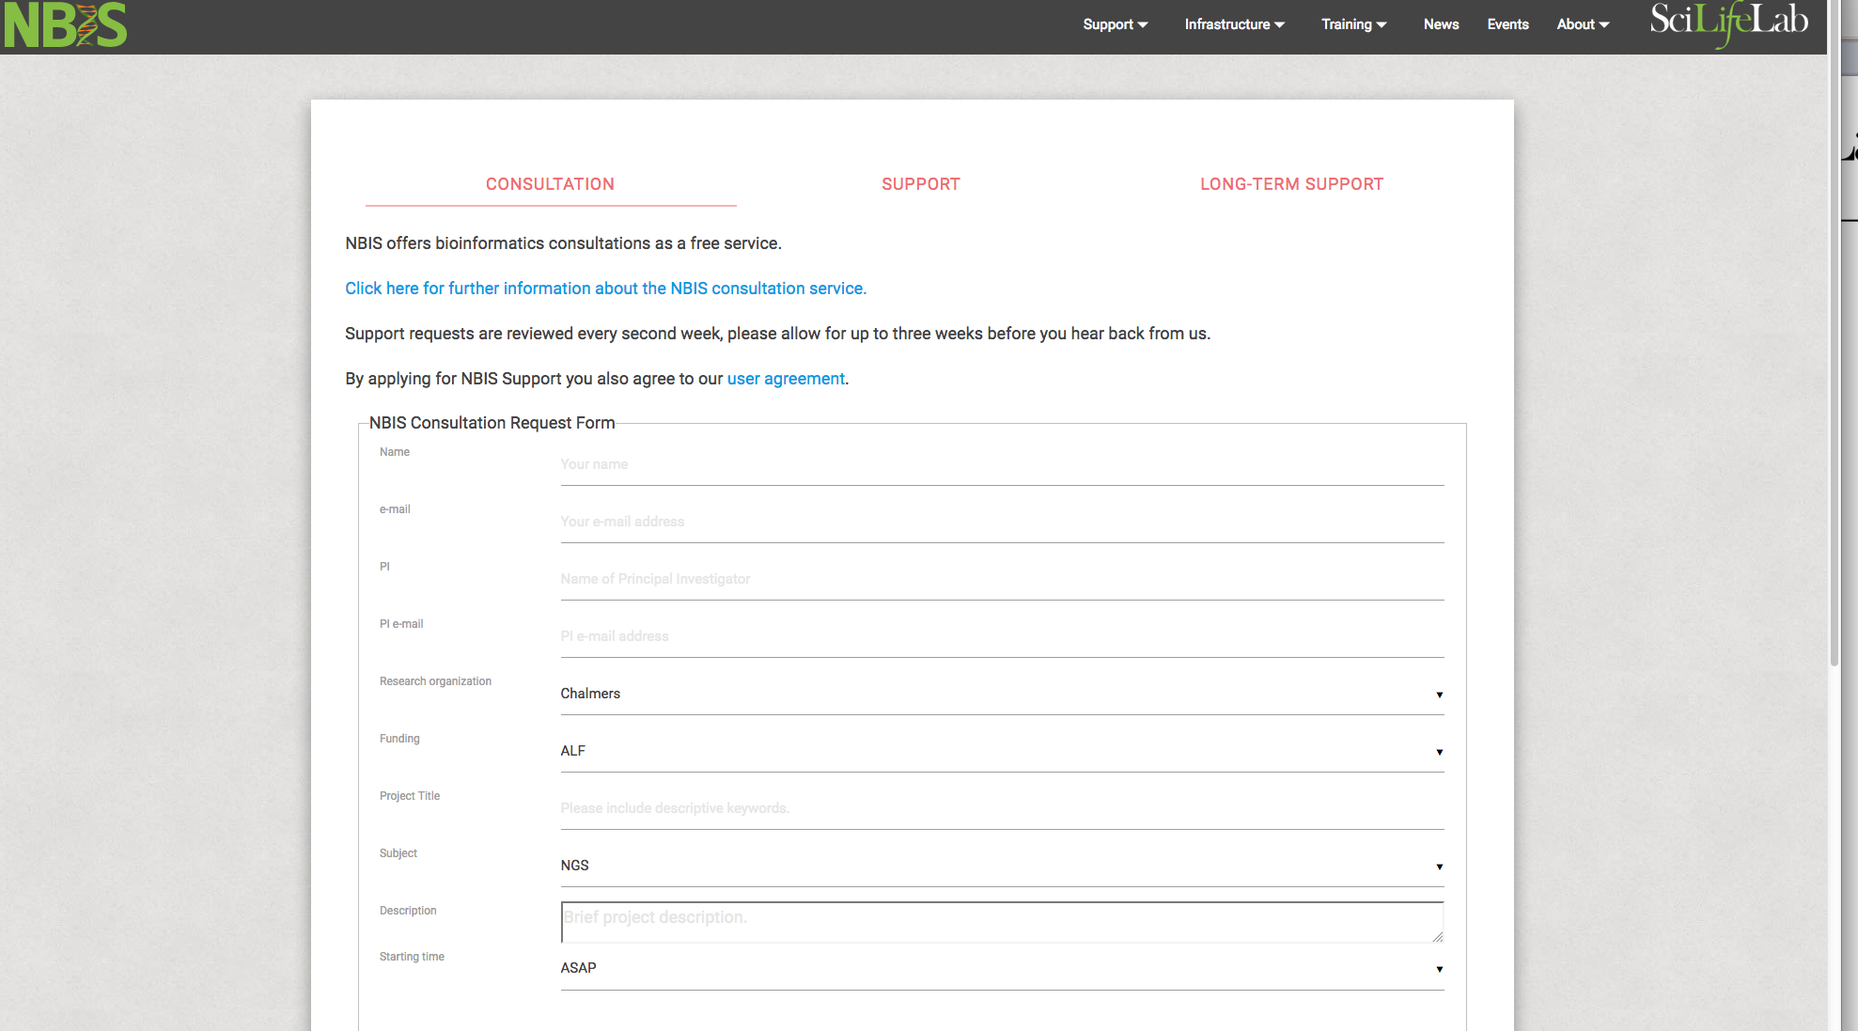
Support form

Slide 19

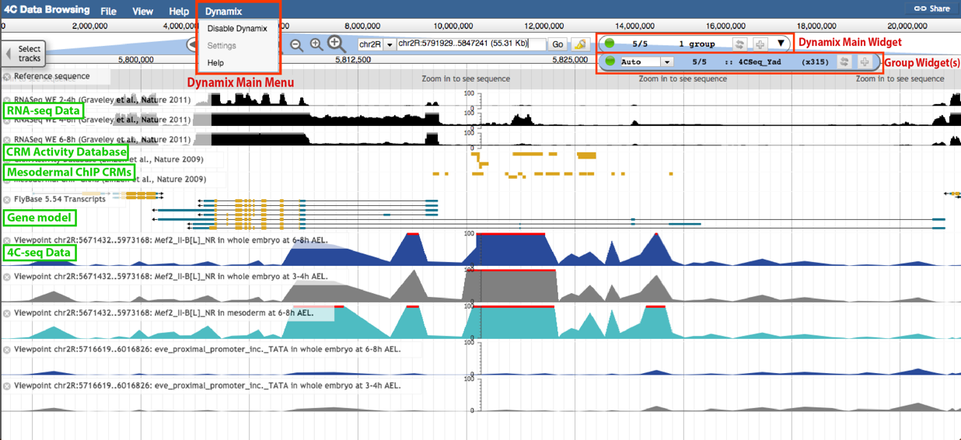
Genome assembly and annotation
Henrik Lantz
10 - 20 projects per year
Highly specialized staff and robust pipelines
Tight user interaction
Numerous manual and semi-manual QC steps
Supports ENA submission
Editable user interface
Cost effective with high quality!

Slide 20
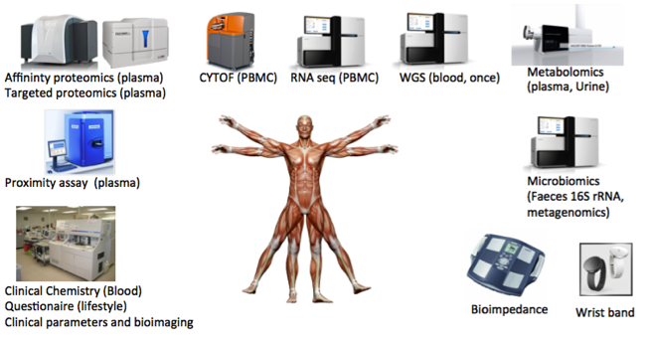
BigData/Integrative omics
4 FTE, joint effort by Long-term Support and Systems Biology
Projects apply in the regular Long-term Support calls
Combine data from SciLifeLab platforms
Building tools and resources for handling very large and/or complex biological data sets
Typically performed in the context of longer support projects
State-of-the-art analytical methods for integrating multi-modal biological data sets, eg
- Machine learning/deep learning
- Graph-based models
- Genome-scale metabolic models
Support track for integrative projects
First call Feb 2016; First few projects initiated
Involves extensive integration of data

Slide 21
Geographical Distribution of Projects 2015

Slide 22
Tools

Slide 23
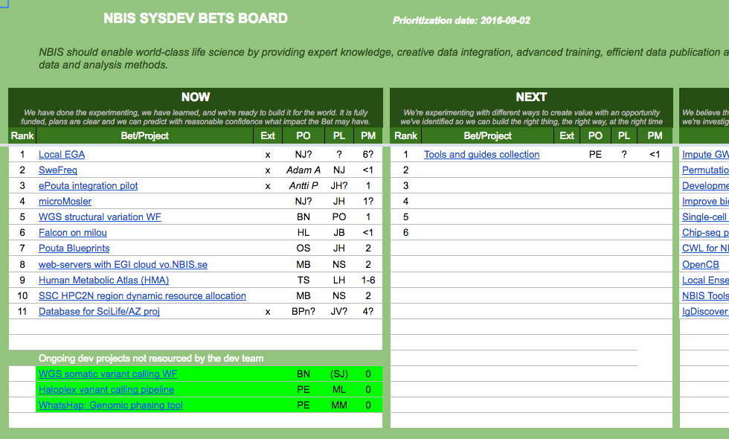
Tools and infrastructure
https://docs.google.com/spreadsheets/d/1PrehKn2eb0ymfaFtCfvbLrOSKtpTL3qLcWZ2YwoXOlU/edit#gid=0
Compute and storage of sensitive data
Local EGA
ePouta integration pilot
microMosler
Pouta Blueprints
web-servers with EGI cloud vo.NBIS.se
WGS tools and resources
SweGen 1000 genomes
WGS somatic variant calling WF
WGS structural variation WF
Software maintenance
MrBayes
Structure prediction web services
Assembly and annotation
Falcon on Milou
ENA submission help
Other tools and resources
Human Metabolic Atlas (HMA)
Haloplex variant calling pipeline
WhatsHap: Genomic phasing
IgDiscover: Immunorepertoire
Open prioritization and background descriptions
Tools and development projects needs to be much more visible! Work in progress…

Slide 24

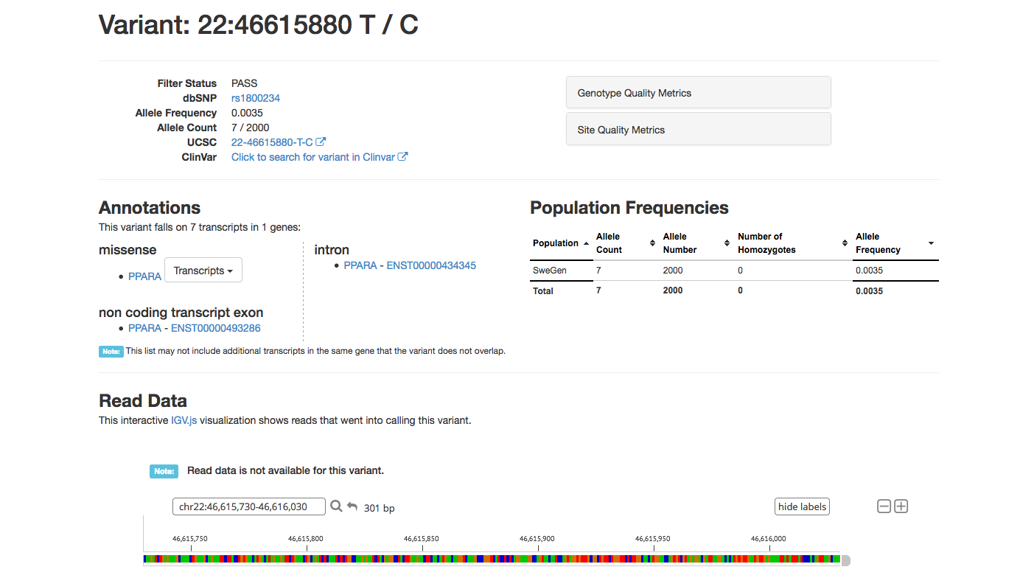
SweGen: 1000 Swedish genomes
SweGen Variant Frequency Database
950 twin registry + 50 Northern Sweden
Deep coverage WGS (30X)
ExAC browser interface
Data Beacon
Full SNP frequency table download
https://swefreq.nbis.se/#/
1st release October 2016!
Funding: SciLifeLab
Sequencing: NGI
Variant calling: NGI
QC: NBIS
Data access interface: NBIS

Slide 25
Training

Slide 26
Outreach & Training
Gender balance:
54% female / 46% male
Bioinformatics Drop-In
Weekly at all sites – initial consultations
20-odd courses every year
Introduction to Bioinformatics using NGS
Introduction to Linux
Perl programming
Introduction to genome annotation
Introduction to multivariate analysis
RNA-seq
Advanced workshop on NGS data analysis
Advanced functional genomics
Advanced bioinformatics
Additional local activities
Bioinformatics Advisory programme
Mentorship in bioinformatics
From spring 2017, we plan to double our training efforts to match the increased demands from the scientific community
www.scilifelab.se/education/courses/
www.nbis.se/training/events.html

Slide 27
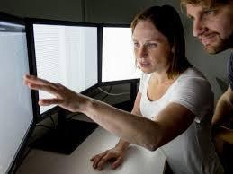
Teaching and mentoring
The Swedish Bioinformatics Advisory Program
PhD students get a senior bioinformatician as a personal advisor during 2 years of their PhD. Monthly project meetings + two grand meetings per year to aid networking and knowledge transfer.
www.scilifelab.se/education/mentorship/the-swedish-bioinformatics-advisory-program/
Recent call (2017/2018): 111 applicants for 15 places (!)

Slide 28
Elixir

Slide 29

Why ELIXIR?
Creating a robust infrastructure for biological information is a bigger task than any individual organisation or nation can take on alone
These are issues of such complexity that no single institution or country can tackle alone
Biology has by far the largest research community:
~3 million life science researchers in Europe
>7 million web hits a day at EMBL-EBI alone

Slide 30
ELIXIR connects national bioinformatics centres and EMBL-EBI into a sustainable European infrastructure for biological research data
medicine
agriculture
bioindustries
ELIXIR underpins life science research – across academia and industry
environment

Slide 31

We’re here for you! nbis.se

